Slide 1
Human Action Recognition and Localization in videos
Stathis Galanakis

Slide 2
Outline
Introduction
Background
Network’s structure
Conclusion - Feature steps

Slide 3
Introduction

Slide 4
Task description:
The area of human action recognition and localization has 2 main goals:
Automatically detect and classify any human activity, which appears in a video.
Automatically locate in the video, where the previous actions are performed.

Slide 5
Task description:
Run

Slide 6
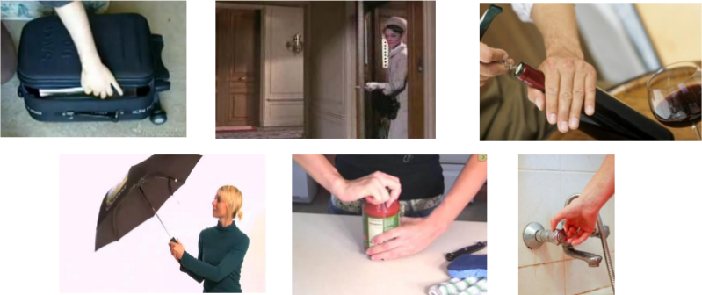
Challenges:
Large variations in the appearance of the actors
Camera viewpoint changes
Too many different action classes
Unspecified vocabulary of the actions

Slide 7
Motivation
Object Detection Networks have achieved very high classification performance regarding the task of detecting objects in an image
3D CNNs classify videos containing human actions with high precision results
The combination of those two types of networks would achieve good results regarding the task of action recognition and localization.

Slide 8
Background

Slide 9
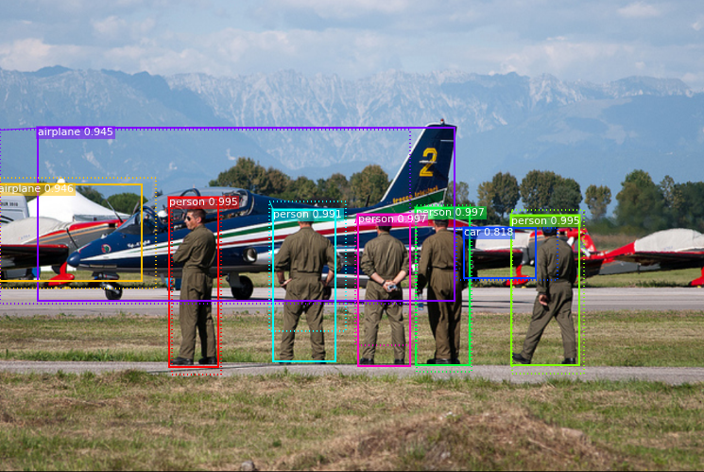
Object Detectors
Their purpose is to detect all appearing objects in an image (i.e. people, building etc)
Used in applications regarding video surveillance, self-driving cars, object tracking
Many action localization applications use an Object Detector or are a 3D extension of it
Known Object Detectors : Mask RCNN, Faster RCNN, YOLO, SSD

Slide 10
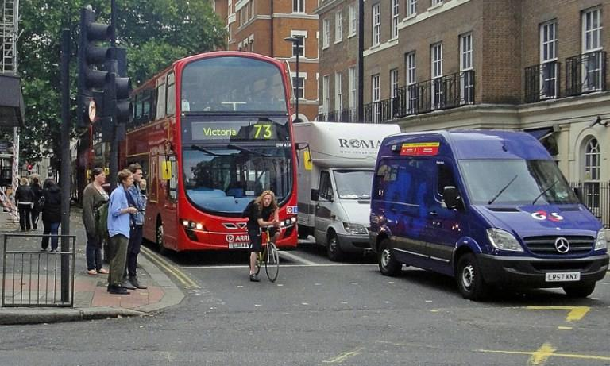
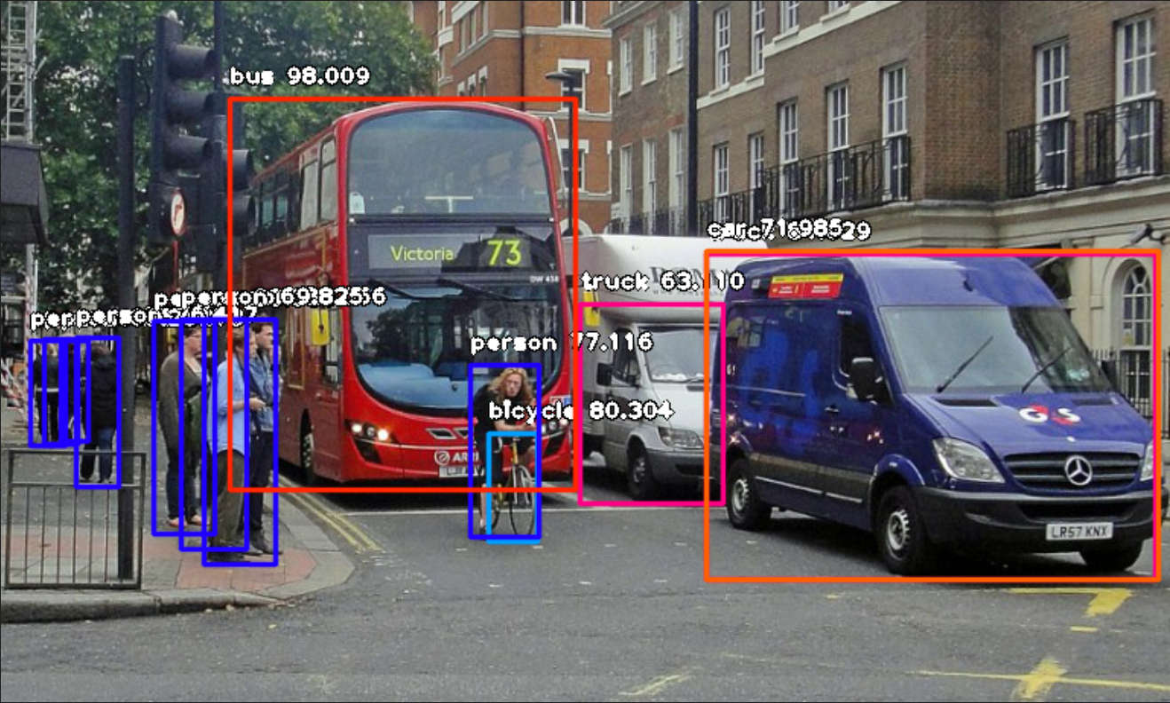
Example of using an Object Detector:

Slide 11
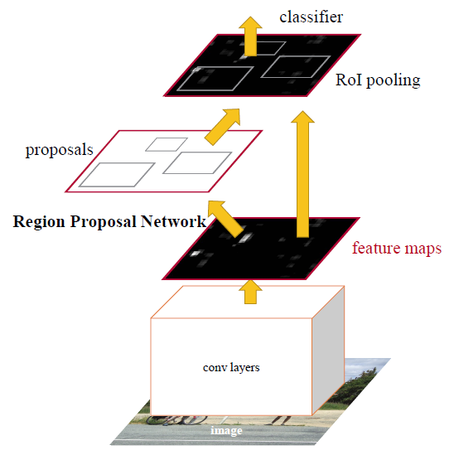
Faster RCNN:
It is consisted of:
The first Convolutional Layers of a pre-trained CNN (VGG, ResNet101)
A RPN
A Classifier
Purpose of the RPN :
To propose areas in the image, which are likely to contain an object

Slide 12
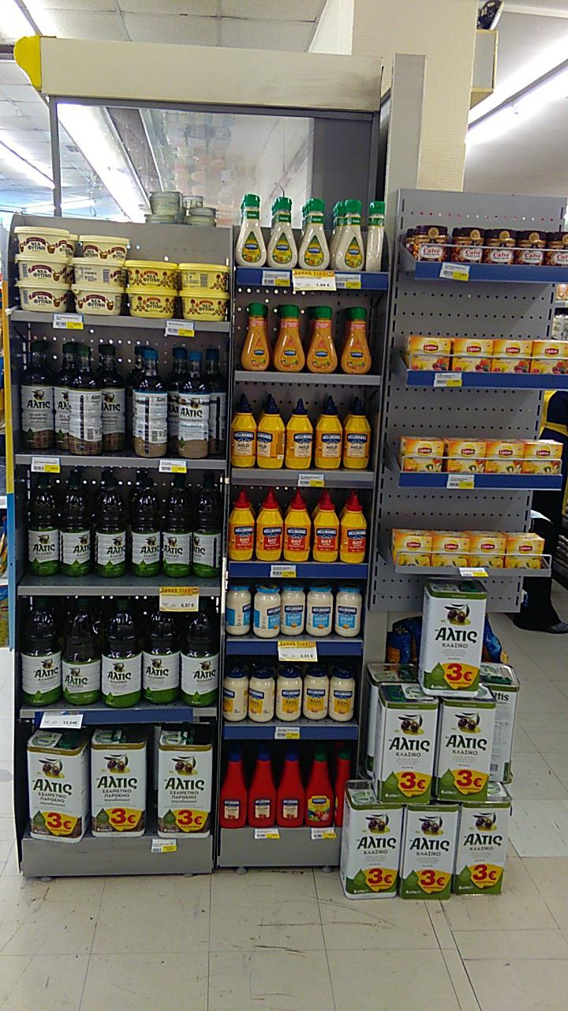
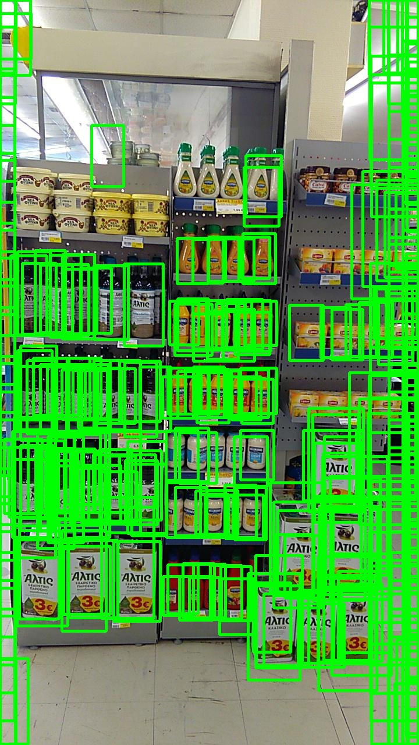
Example of using the RPN:

Slide 13
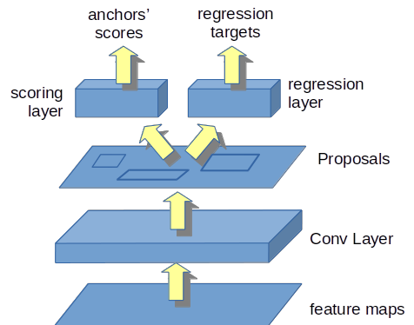
RPN’s structure
RPN is consisted of:
1 2D Convolutional Layers
1 Scoring Layer
1 Regression Layer
RPN’s steps:
VGG’s features are given as input to the 2D Conv Layer
For every pixel, k (k=9) boxes are used for proposals (3 scales, 3 aspect ratios)
The scoring layer outputs confidence score whether there is an item or not.
The regression layer outputs 4 coords for each anchor

Slide 14
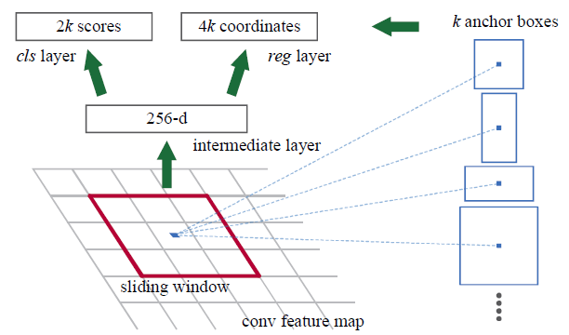
RPN’s structure
RPN is consisted of:
1 2D Convolutional Layers
1 Scoring Layer
1 Regression Layer
RPN’s steps:
VGG’s features are given as input to the 2D Conv Layer
For every pixel, k (k=9) boxes are used for proposals (3 scales, 3 aspect ratios)
The scoring layer outputs confidence score whether there is an item or not.
The regression laye outputs 4 coords for each anchor

Slide 15
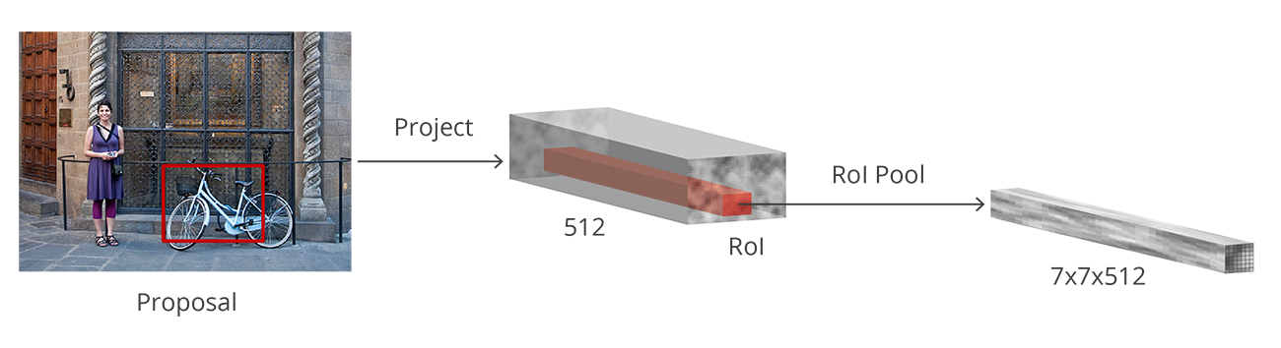
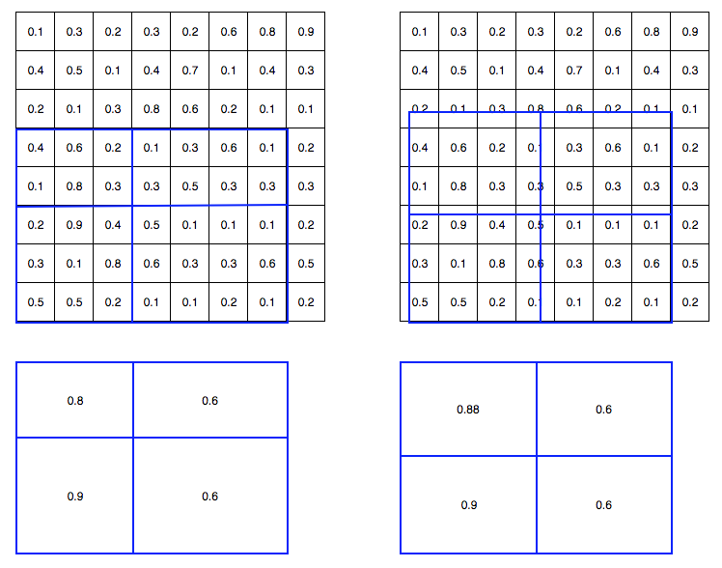
Roi Align
Introduced by Mask-RCNN
Used for extracting feature maps with fixed sized using variable size region proposals
Used instead of Roi Pooling
Instead of max pooling (Roi Pooling), it uses bilinear interpolation
It increased results’ performance

Slide 16
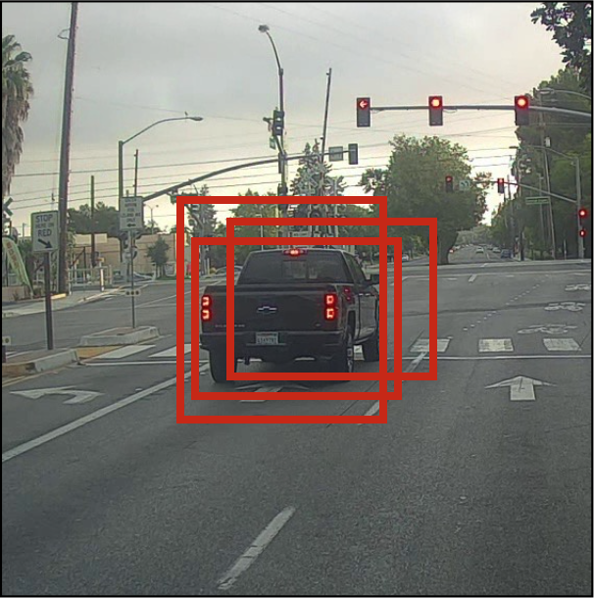
Non maximum suppression algorithm (NMS)
Usage : Deletes overlapping predictions that represent the same object
Reduces noticeably the number of False Positives

Slide 17
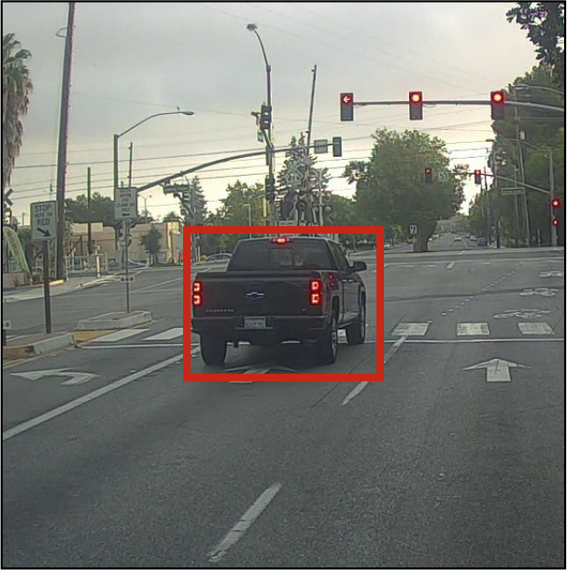
Non maximum suppression algorithm (NMS)
Usage : Deletes overlapping predictions that represent the same object
Reduces noticeably the number of False Positives

Slide 18
Losses & Metrics
Losses:
Cross-Entropy Loss
Smooth-L1 Loss
Metrics
Intersection Over Union (IoU)
Recall
Mean Average Precision (mAP)
Mean Average Best Overlap (MABO)

Slide 19
Network’s structure

Slide 20
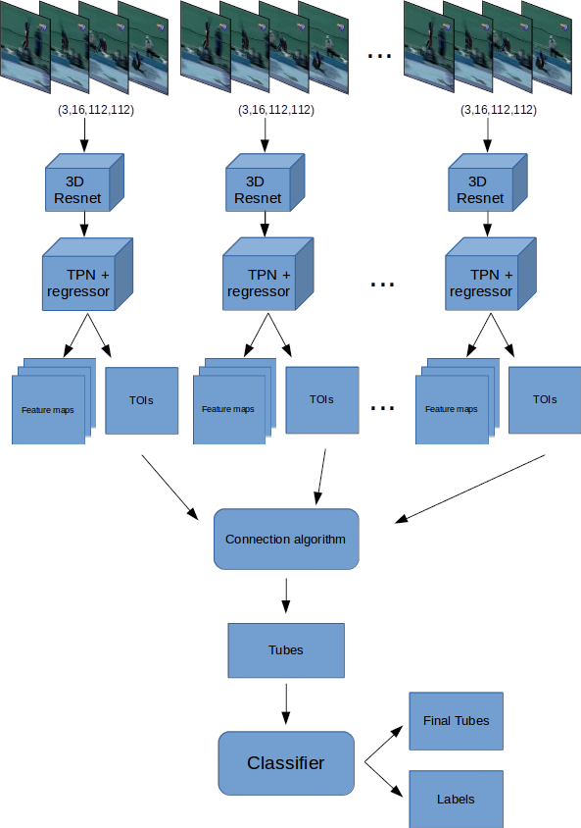
Model’s structure
3D ResNet34
Tube Proposal Network
Classifier
Datasets: JHMDB, UCF-101
Based on:
R. Hou C. Chen. and M. Shah “Tube Convolutional Neural Network (T-CNN) for Action Detection in Videos
R. Girdhar et al. “Detect-and-Track: Efficient Pose Estimation in Videos”
S. Ren et al. “Faster R-CNN: Towards Real-Time Object Detection with Region Proposal Networks”.
Jianwei Yang et al. “A Faster Pytorch Implementation of Faster R-CNN”
Bo Hu et al. “Progress Regression RNN for Online Spatial-Temporal Action Localization in Unconstrained Videos”

Slide 21
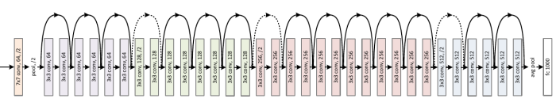
3D ResNet 34
3D ResNet 34
We extract the 3 first Layer groups from a pre-trained model, trained at Kinetics dataset
Trained for sample duration = 16 frames
Frame size = (112, 112)

Slide 22
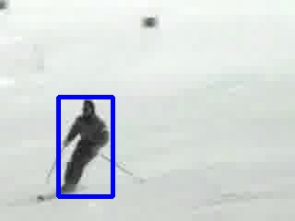
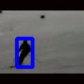
Video preparation
3D ResNet 34
Need for fixed input size per frame → Resize video frame
Need for maintaining frame’s aspect ratio → Zero padding either up and down, either left and right

Slide 24
Tube proposal Network (TPN)

Slide 25
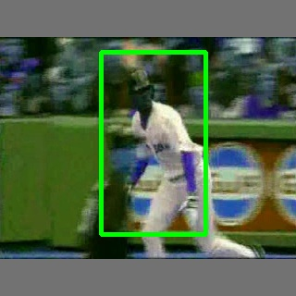
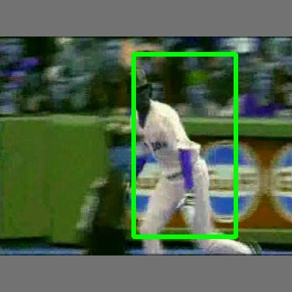
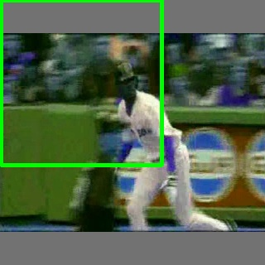
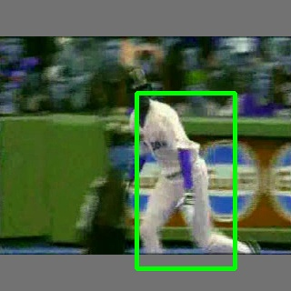
Usage
Tube Proposal Network
Input: Feature maps extracted from videos containing 16 frames
Output: Sequences of 2D bounding boxes, which are likely to contain a performed action. These sequences are named Tubes of Interest (ToIs)

Slide 26
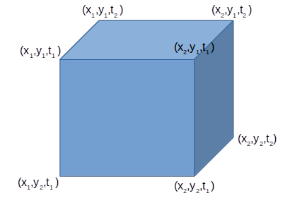
TPN - 1st approach
Tube Proposal Network
The anchors are considered as 6-dim vectors (x₁, y₁, t₁, x₂, y₂, t₂ )
DImensions (x-y-t) are changeable
60 anchors are used for every pixel of the feature map:
5 scales
3 aspect ratios : 1:1, 1:2, 2:1
4 durations: 16, 12, 8 and 4 frames
The same anchors are used for both datasets in order to be able to generalize our approach

Slide 27
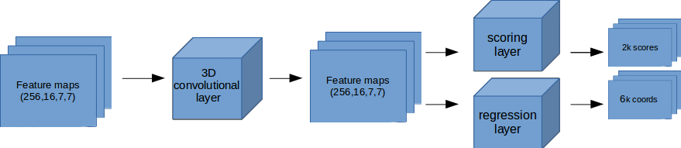
TPN’s structure
Tube Proposal Network
TPN - 1st approach
1 3D Convolutional Layer
1 Scoring Layer
1 Regression Layer

Slide 28
TPN’s procedure
Tube Proposal Network
TPN - 1st approach
1 3D Convolutional Layer
1 Scoring Layer
1 Regression Layer

Slide 29
TPN’s procedure
Tube Proposal Network
TPN - 1st approach
1 3D Convolutional Layer
1 Scoring Layer
1 Regression Layer

Slide 30
TPN’s procedure
Tube Proposal Network
TPN - 1st approach
1 3D Convolutional Layer
1 Scoring Layer
1 Regression Layer

Slide 31
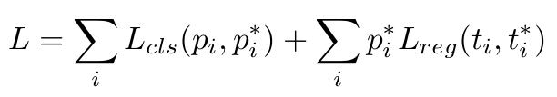
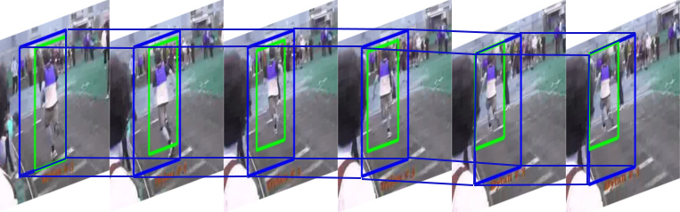
Training
Tube Proposal Network
TPN - 1st approach
We randomly choose 16 frames from every video and their corresponding groundtruth boxes.
Groundtruth action tubes are converted to groundtruth cuboids
Anchors are compared with groundtruth cuboids
Training loss :

Slide 32
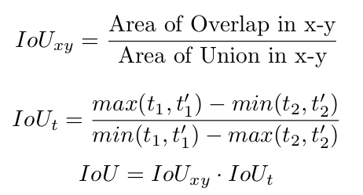
Modified Intersection Over Union (m-IoU)
Tube Proposal Network
TPN - 1st approach
Standard IoU for volumes:
Calculates overlap score between 2 cuboids
x-y dims are equal important as t-dim
Modified-IoU:
Changes the importance between t-dim and x-y dims
m-

Slide 33
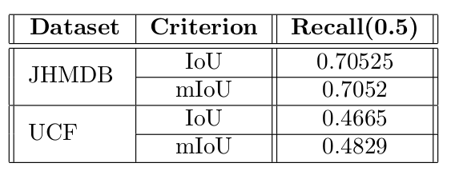
mIoU - Results
Tube Proposal Network
TPN - 1st approach
mIoU performs better at Dataset UCF-101
Dataset JHMDB isn’t affected

Slide 34
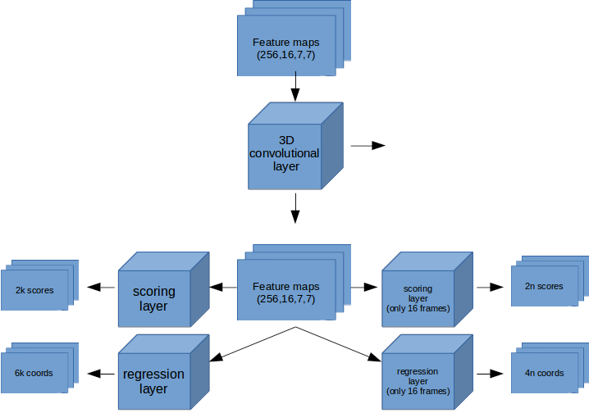
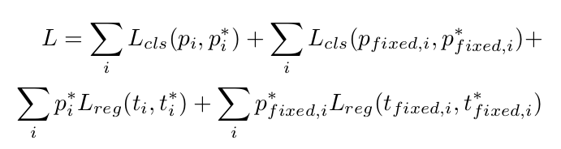
Improving TPN
Tube Proposal Network
TPN - 1st approach
Most actions last more than 16 frames.
We add 1 Scoring and 1 Regression Layer
2 approaches for «compressing» time dimension context
3D Convolutional Layer, kernel (16,1,1), stride 1, no pad
Avg pool + 2D Convolutional Layer
New Training Loss formula:

Slide 35
Improving TPN
Tube Proposal Network
TPN - 1^{η} προσέγγιση
Most actions last more than 16 frames.
We add 1 Scoring and 1 Regression Layer
2 approaches for «compressing» time dimension context
3D Convolutional Layer, kernel (16,1,1), stride 1, no pad
Avg pool + 2D Convolutional Layer
New Training Loss formula:

Slide 36
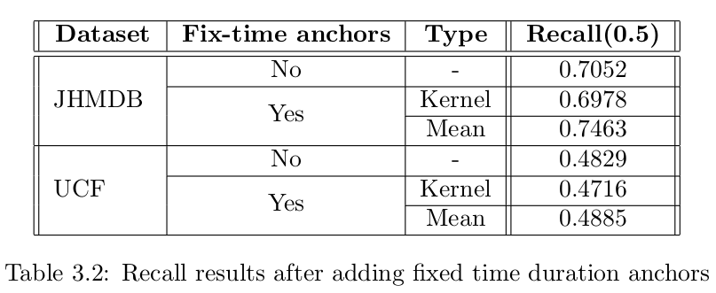
Results
Tube Proposal Network
TPN - 1st approach
For dataset JHMDB, Avg pooling + 2D Conv Layer performs slightly better,
For dataset UCF-101 we get about the same results (+0.005)

Slide 37
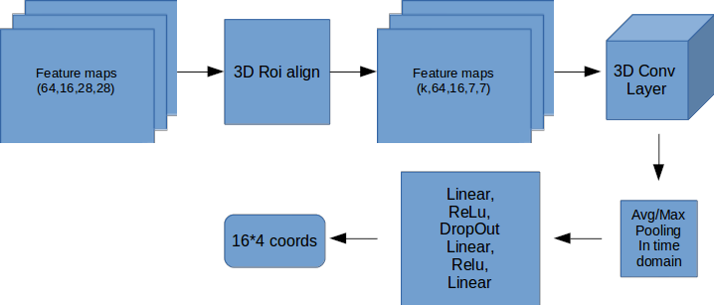
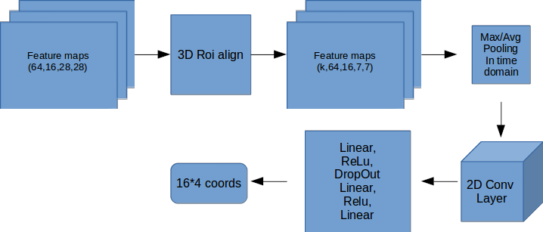
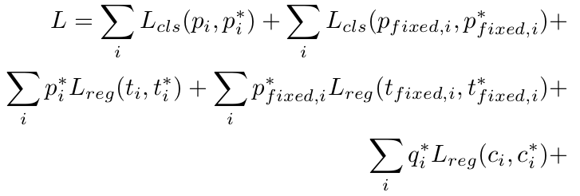
Adding Regressor
Tube Proposal Network
TPN - 1st approach
1st architecture
2 architectures
Goal: converting cuboids into sequences of 2D bounding boxes, one per frame
Smooth-L1 loss as training loss
Training loss :
2nd architecture

Slide 38
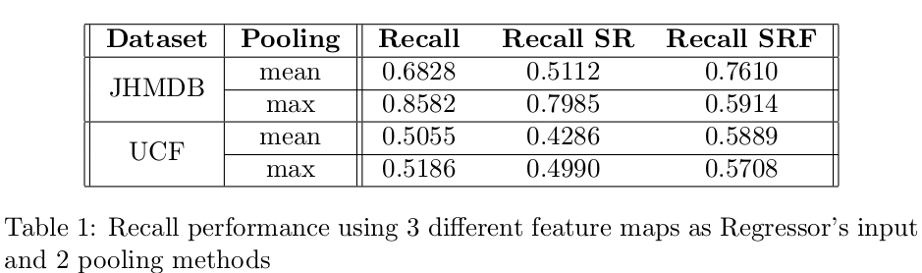
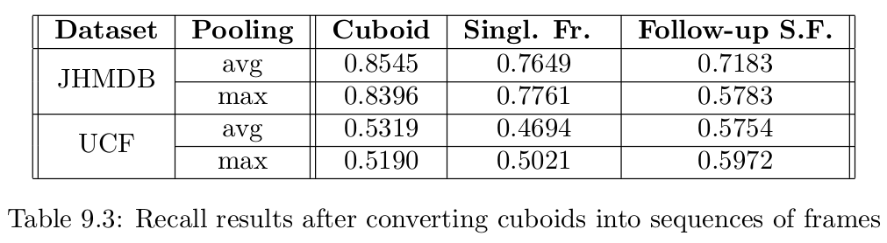
Results
Tube Proposal Network
TPN - 1st approach
We use the following metrics:
Cuboid Recall, recall between cuboids
Single frame Recall, final recall in ToI level
Follow-up Single Frame Recall, recall regarding only “good” cuboids
We lose about 30%-40% from “good” Cuboids during the conversion.

Slide 39
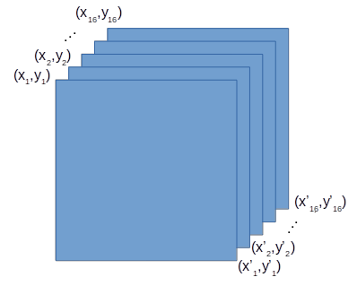
TPN - 2nd approach
Tube Proposal Network
TPN - 2nd approach
Anchors : as 4k-dim vectors (x₁, y₁, x’₁, y’₁, x₂, y₂, x’₂, …, y’_{k} )
x-y dims are changeable, t-dim is fixed
Anchors with smaller duration are written are anchors with zeroed values outside the time limits
Advantage: We get ToIs immediately, without using necessarily a Regressor
Training Loss :

Slide 40
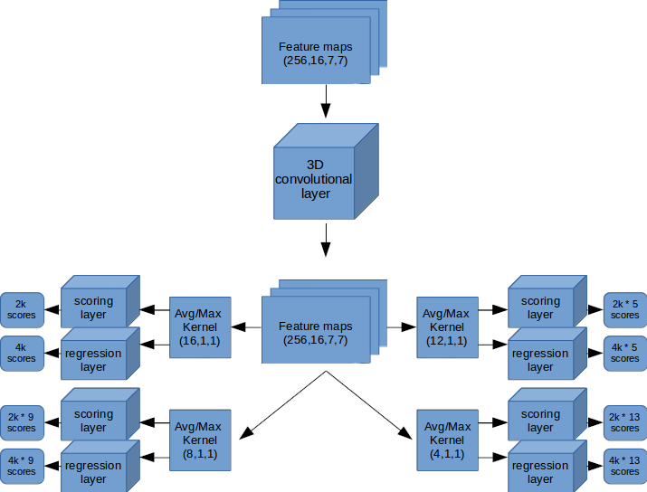
TPN’s procedure
Tube Proposal Network
TPN - 2nd approach
The features extracted from 3D ResNet are given to 3D Conv Layer

Slide 41
TPN’s procedure
Tube Proposal Network
TPN - 2nd approach
The features extracted from 3D ResNet are given to 3D Conv Layer
In order to get features for each duration, we use pooling with kernel (durαtion,1,1)

Slide 42
TPN’s procedure
Tube Proposal Network
TPN - 2nd approach
The features extracted from 3D ResNet are given to 3D Conv Layer
In order to get features for each duration, we use pooling with kernel (durαtion,1,1)
Finally, the features are fed to the corresponding scoring and regression layers

Slide 43
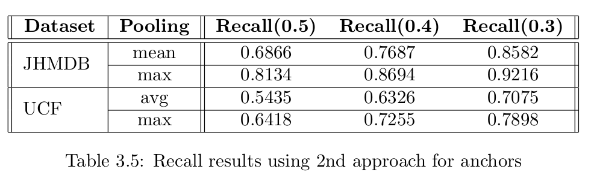
Results
Tube Proposal Network
TPN - 2nd approach
JHMDB → Improvement by 1% (80.22% previously)
UCF-101 → Improvement by 14% (49.90% previously)
Max pooling performs better than avg pooling

Slide 44
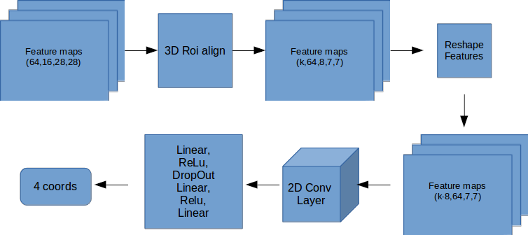
Adding Regressor
Tube Proposal Network
TPN - 2nd approach
1st architecture
2 Regressor’s architectures
New 2D architecture: The feature maps are timely independent
3D Roi Align = T slices · 2D Roi Align
Training Loss :
2nd architecture

Slide 45
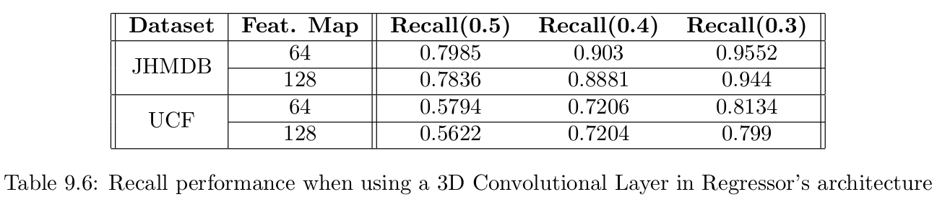
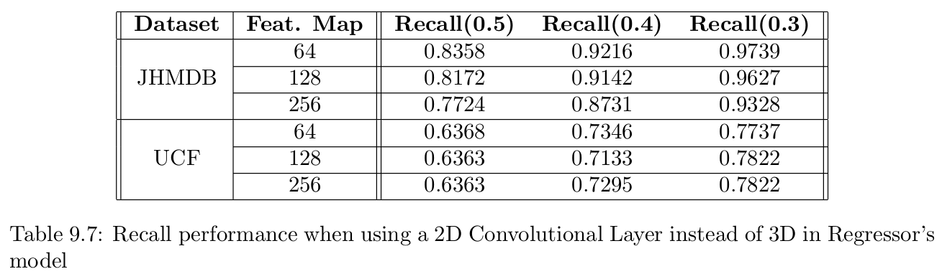
Results
Tube Proposal Network
TPN - 2nd approach
3D architecture → worst results
2D architecture
better results JHMDB (81.34% previously)
slightly worse results UCF-101 (64.18% previously)

Slide 46
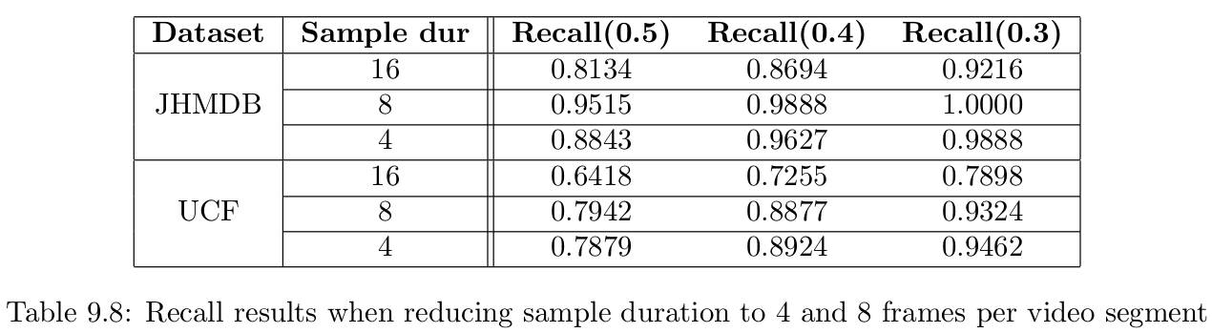
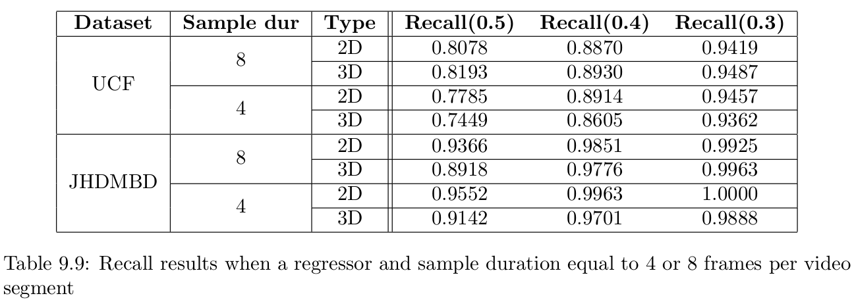
Reducing sample duration into 8 and 4 frames
Tube Proposal Network
TPN - 2nd approach
Best general approach:
Sample duration = 8 frames
2D Regressor

Slide 48
Connection algorithm

Slide 49
Usage:
Connection algorithm

Slide 50
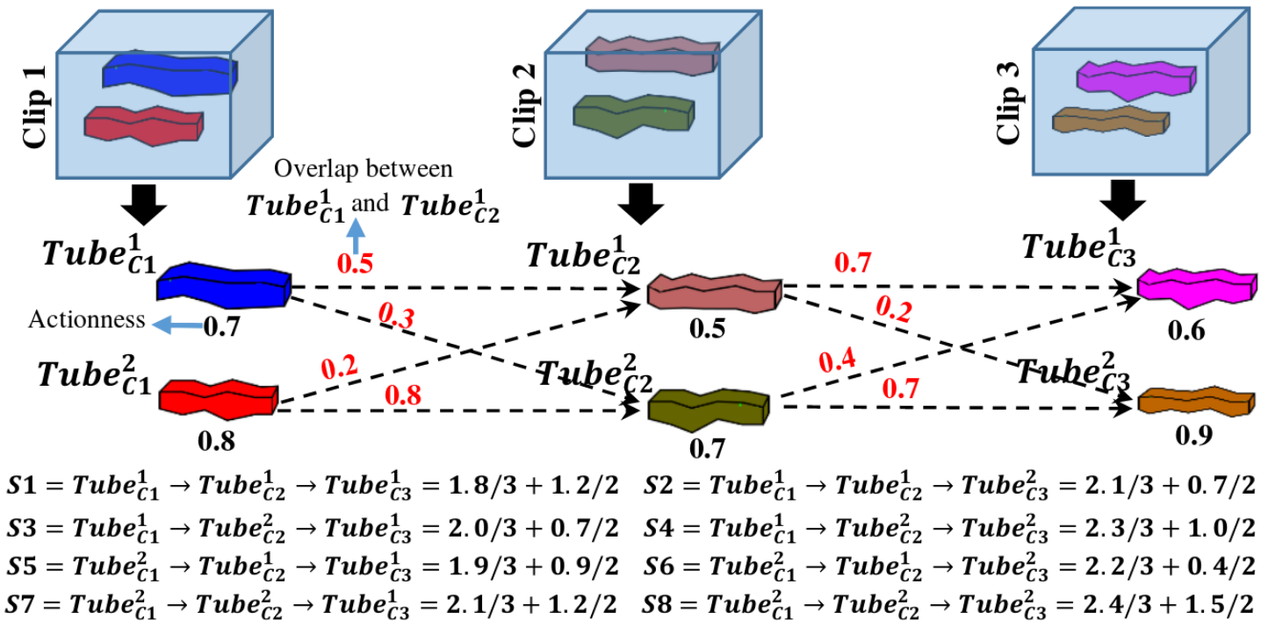
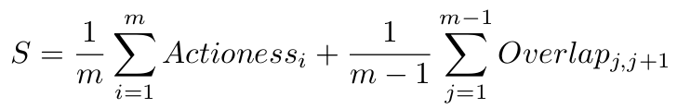
1st algorithm
Connection algorithm
1st algorithm
A variation of connection algorithm used in the 1st paper
Connection criterion for 2 tubes:
Using an updatable threshold in order not to calculate action tubes with small connection score

Slide 51
Overlap score calculation policy - JHDMB dataset
Connection algorithm
1st algorithm
JHMDB dataset is used for choosing best overlap score policy
Experiment for following cases:
sample duration = 16 and video step : 8, 12, 14, 15, 16
sample duration = 8 and video step : 4, 6, 7, 8
Best policy :
video step = sample duration
Best recall scores :
sample duration = 16 → 0.4067
sample duration = 8 → 0.653

Slide 52
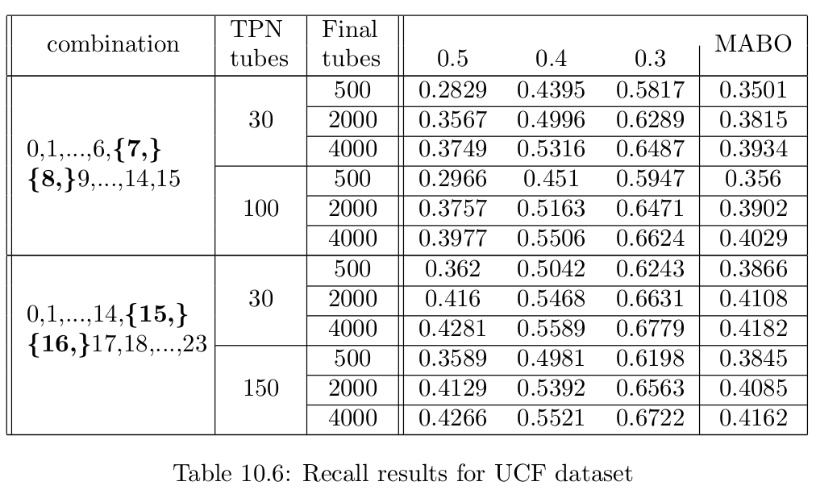
Calculating number of proposed action tubes -
UCF-101
Connection algorithm
1st algorithm
Cases :
sample duration : 8, 16
# ToIs : 30, 100 or 150
# Proposed Action Tubes : 500, 2000, 4000
Best score: 0.4281
sample duration = 16
# ToIs : 150
# Proposed Action Tubes : 4000

Slide 53
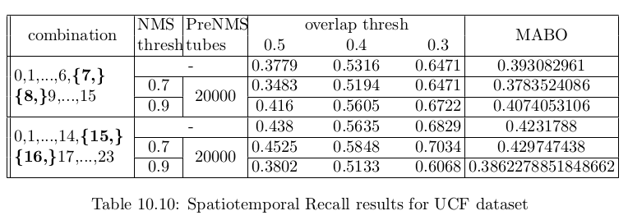
Adding NMS - UCF-101
Connection algorithm
1st algorithm
Threshold stops being updated
Adding NMS for removing overlapping proposed action tubes
Best results : sample duration = 16 frames, NMS thresh = 0.7

Slide 54
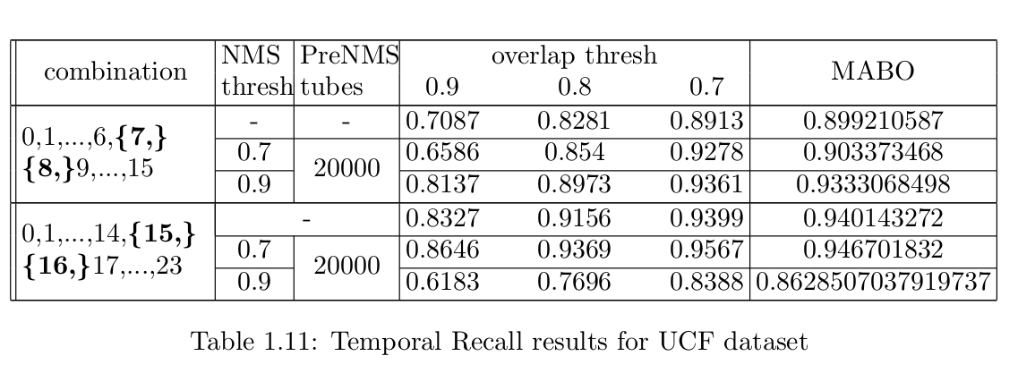
Temporal recall
Connection algorithm
1st algorithm
Spatio-temporal recall : less than 50%.
Temporal recall : about 94%.

Slide 55
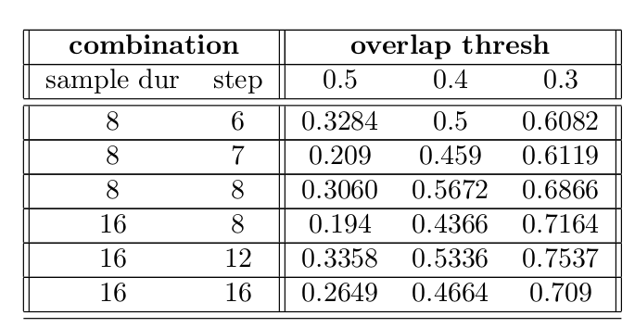
2nd algorithm
Connection algorithm
2nd algorithm
Based on 5th paper
Introduced :
Progression, the probability of a specific action class to be performed
Progress rate, the proportion of the performed action that has been completed
2 action tubes are linked if :
Overlap score > θ
Progress rate are close
For every action class, keep Κ-best-scoring action tubes
Experiment only for JHMDB : worst results than previous algorithm

Slide 56
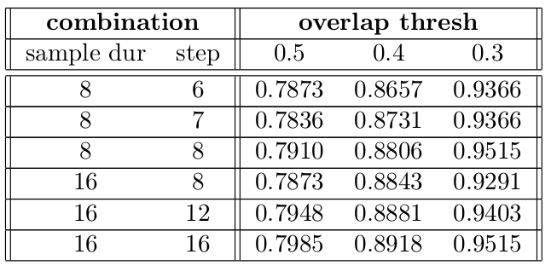
3rd algorithm
Connection algorithm
3rd algorithm
Implemented only for JHMDB
Calculates all possible combinations of ToIs
Keep only K-best-scoring action tubes
Best recall performance for JHMDB

Slide 57
Classification stage
JHDMB Dataset
UCF-101 Dataset

Slide 58
JHMDB - Spatiotemporal localization results
Classification stage
JHMDB Dataset
JHMDB is consisted of 21 action classes
We use 4 types of classifiers:
Linear, RNN, SVM and MLP
We use feature maps extracted from 3D Roi Align
Explore ratios between foreground and total action tubes

Slide 59


First training
Classification stage
JHMDB Dataset
During training : Use pre-extracted feature maps of
1 foreground tube
2 background tubes
For SVM, Linear we explore best pooling method
For SVM we explore 2 different feature maps
Results:
Avg pooling for Linear
Max pooling for SVM

Slide 60
Other experiments
Classification stage
JHMDB Dataset
Temporal pooling used for SVM
Change sample duration into 16 frames
Use MLP
Increase foreground and background action tubes
Classifier | FG tubes | Total Tubes | mAP
 |  |  | 0.5 | 0.4 | 0.3
Linear | 8 | 12 | 17.91 | 22.51 | 24.62
RNN | 4 | 8 | 20.73 | 28.25 | 29.50
MLP | 8 | 32 | 13.27 | 17.64 | 18.97
SVM | 4 | 6 | 25.04 | 26.91 | 27.82

Slide 61
UCF-101 : Temporal Localization
Classification stage
UCF-101 Dataset
UCF-101 : 24 action classes
Connection algorithm
doesn’t generate good spatiotemporal action tubes,
generates good temporal tubes
Experiment using our architecture as a temporal localization network

Slide 62
1st method
Classification stage
UCF-101 Dataset - 1st method
We train a seperate 3D ResNet34 at UCF-101 dataset
After generating proposed action tubes, we extract their temporal context (temporal tubes).
We remove double temporal tubes and classify
Based on confidence scores, NMS removes overlapping temporal tubes
Keep detections whose score > confidence threshold

Slide 63


Results
Classification stage
UCF-101 Dataset - 1st method
Best score:
8.37 when NMS thesh = 0.2 confidence thresh = 0.6

Slide 64
2nd method
Classification stage
UCF-101 Dataset - 2nd method
Same procedure for extracting temporal tubes
Train only the last layer group of a 3D ResNet34 pre-trained at Kinetics dataset

Slide 65


Results:
Classification stage
UCF-101 Dataset - 2nd method
Best score:
50.01 when NMS thresh =0.3, confidence thresh = 0.6

Slide 66
Conclusion - Feature work

Slide 67
Contributions:
We implement an Action Recognition and Localization network mainly based on our own code
We extend RPN’s architecture in 3 dimensions, implementing a Tube Proposal Network.
2 definitions for the anchors and respectively 2 approaches.
2 Regressor architectures for each approach.
We implement 3 connection algorithms for linking ToIs
We explore our network’s classification and temporal localization capabilities

Slide 68
Feature work
Explore better anchor for even better proposals
1st approach : use more complicated anchor’s shapes
2nd approach : add anchors with other duration with varying bounding boxes
Change TPN’s training loss adding factors λ₁, λ₂ in order to better balance training loss factors
Change connection algorithm
Explore new classification techniques
For JHMDB explore processing feature maps techniques before classification
Experiment UCF-101 for Action Localization

Slide 69

Questions?

